Slide 1

Inheritance in Python

Slide 2

Objectives
Inheritance
What is inheritance?
How does it relate to Python?

Slide 3
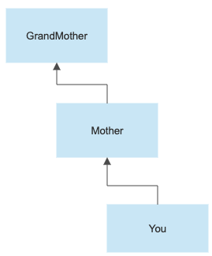
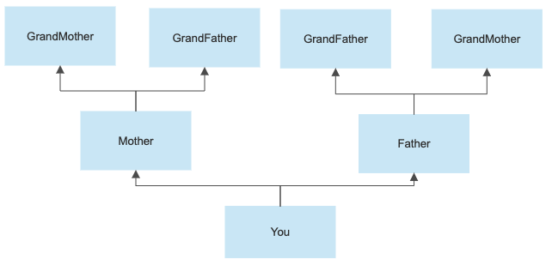
Inheritance
Parent to child relationships
Inheritance.
Personality traits.
Python inheritance
Parent class / Super class.
Child class / Sub class.

Slide 4
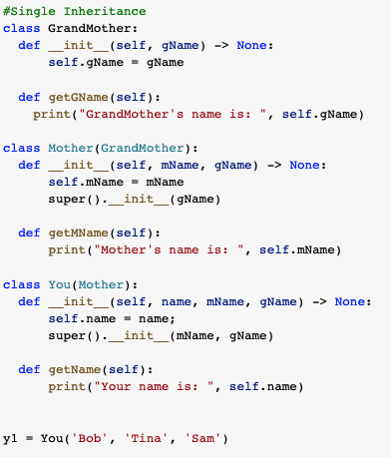
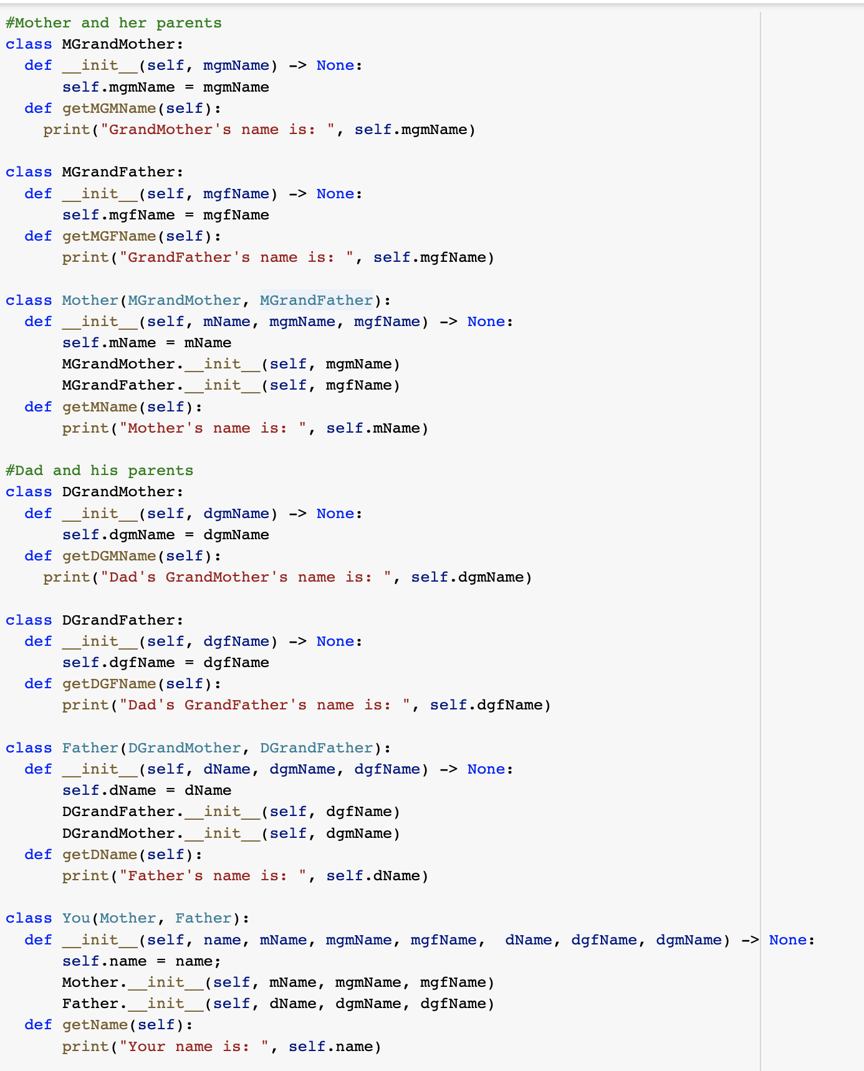
Inheritance
Level
Single.
Super call.
Multiple.
Method Resolution Order (MRO).
Left to right.
Explicit call.

Slide 5
Demo

